Slide 1



Implement the monolith
A modularized one
jacek.milewski.k@gmail.com
@jacek_mil
Jacek Milewski

Slide 2
Start with monolith first
Distributed Monolith
Microservices
Distribution
Big Ball Of Mud
Modularized Monolith
Modularization

Slide 3
A kind of agenda
Strategy: My path and decisions
Tactics: How things are implemented
* Focus on interactions between modules (not defining the modules)
Notes:
Strategy: Will show our path and approach
Maybe you'll recognize you're at some stage of this path
Then share your experiences
Watch which route we took from this point, consider it for you
Disclaimer
I'm a type of person that spends long time with a product, observing the consequences of decisions made
Different type of experience than a consultant switching products
Therefore, will show my perspective and conditions that were present so you can have full picture and assess yourselves
Tactics: Will also focus on how we coded things
what generic problems we faced
Focus on integration and interactions between modules
not discussing module internals
not saying on how module boundaries should be defined. But discussing technical aspects of already defined boundaries and rules

Slide 4
Long story short

Slide 5

The monolith or a microservice?
Identity Management system for Customers
Internal microservice used by other services
Notes:
It is just one of the components across the whole ecosystem
CIAM: A supporting / generic subdomain
Looking at the internals however, It has several apparent modules / subdomains

Slide 6
The perfect microservice
OAuth & User
BE: Controller
BE: Services
BE: DAOs
Test: Integration
Test: Unit
FE: Controllers
FE: Services
FE: Http Clients
Notes:
2017: Project started
As a single module: oauth
Module with packages oriented over layers: daos, services, controllers, etc.
Project was small back then, more like a single module compared to the features it has now
Sounds like a perfect microservice
However today, even this single module is organized differently
Only integration tests were developed back then
And it was fine, enough

Slide 7
We have this one small feature...
2018: GDPR
Belongs to customer Identity Component
But is not much related to authorization
Became a separate... something
Both in BE and FE code
FE reflected BE structure
Module internals we wanted to have flat, not technically layered
Module was small
flat structure is fine, no strong need of nesting, subpackages, etc
Are subpackges bad?
Yes, because they require to use `public` access modifiers

Slide 8
There’s this small feature… GDPR
OAuth & User
GDPR
BE: Controller
BE: Services
BE: DAOs
Test: Integration
Test: Unit
FE: Controllers
FE: Services
FE: Http Clients
Notes:
2018: GDPR
Belongs to customer Identity Component
But is not much related to authorization
Became a separate... something
Both in BE and FE code
FE reflected BE structure
Module internals we wanted to have flat, not technically layered
Module was small
flat structure is fine, no strong need of nesting, subpackages, etc
Are subpackges bad?
Yes, because they require to use `public` access modifiers

Slide 9
And another feature...
2018: T&C Module
Loosely coupled with CIAM
Became more apparent that it's something separate
Naturally, we started to see that some separate modules are emerging
Module concept established
Module Unit tests crafted
Cross-module communication established
However legacy modules were violating it badly

Slide 10
And one more: T&C
OAuth & User
GDPR
T&C
BE: Module API
BE: Controller
BE: Services
BE: DAOs
Test: Integration
Test: Unit
FE: Controllers
FE: Services
FE: Http Clients
Notes:
2018: T&C Module
Loosely coupled with CIAM
Became more apparent that it's something separate
Naturally, we started to see that some separate modules are emerging
Module concept established
Module Unit tests crafted
Cross-module communication established
However legacy modules were violating it badly

Slide 11
Two modules and... the rest
@ModuleApi created for `user` and `oauth2` modules
Designing new modules, deciding on boundaries
Notes:
@ModuleApi created for `user` and `oauth2` modules
The modularization has started for good
new modules popping out
Designing the modules, deciding on a boundaries
Also deciding on module internals and integration between them
Start grouping classes in business-oriented packages
Separating Command Apis from Query Apis
Allows conceptually separate simple APIs from complex ones
Different approach to testing, as Query APIs are simple
Helps avoiding circular dependencies
Being careful on DB-level relationships / constraints / cascades

Slide 12
DB Relations
OAuth & User
GDPR
T&C
BE: Module API
BE: Controller
BE: Services
BE: DAOs
GDPR
Database
Users
T&C

Slide 13
The future: replace Identity module
the main product functionality might be replaced with Off-the shelf solution
Why investing time in modularization and refactoring, then?
let's do it because it's the latest opportunity to do it in this codebase - hurry up and play around! :)
Remaining modules might stay
Seems that we might have the case when one module is cut off to a separate microservice
only part of the product will be replaced.
a part - means one module. then we need to have it separated

Slide 14
Future – replace CIAM
OAuth & User
GDPR
T&C
BE: Module API
BE: Controller
BE: Services
BE: DAOs
Test: Integration
Test: Unit
FE: Controllers
FE: Services
FE: Http Clients

Slide 15
We know where we're going
Modules' definitions are mature and still growing
Current setup works well for a long time
time to strengthen the boundaries
Enforce on new development
Find gaps where we’re not modularized

Slide 16
Broken boundaries
OAuth & User
GDPR
T&C
BE: Module API
BE: Controller
BE: Services
BE: DAOs

Slide 17
Tooling

Slide 18
Is there a tool to help us?
Automate rule checking on new development
Detect where we're not yet modularized

Slide 19
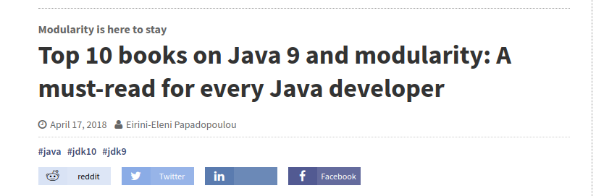

Java 9
https://jaxenter.com/top-10-books-on-java-9-modularity-143518.html

Slide 20
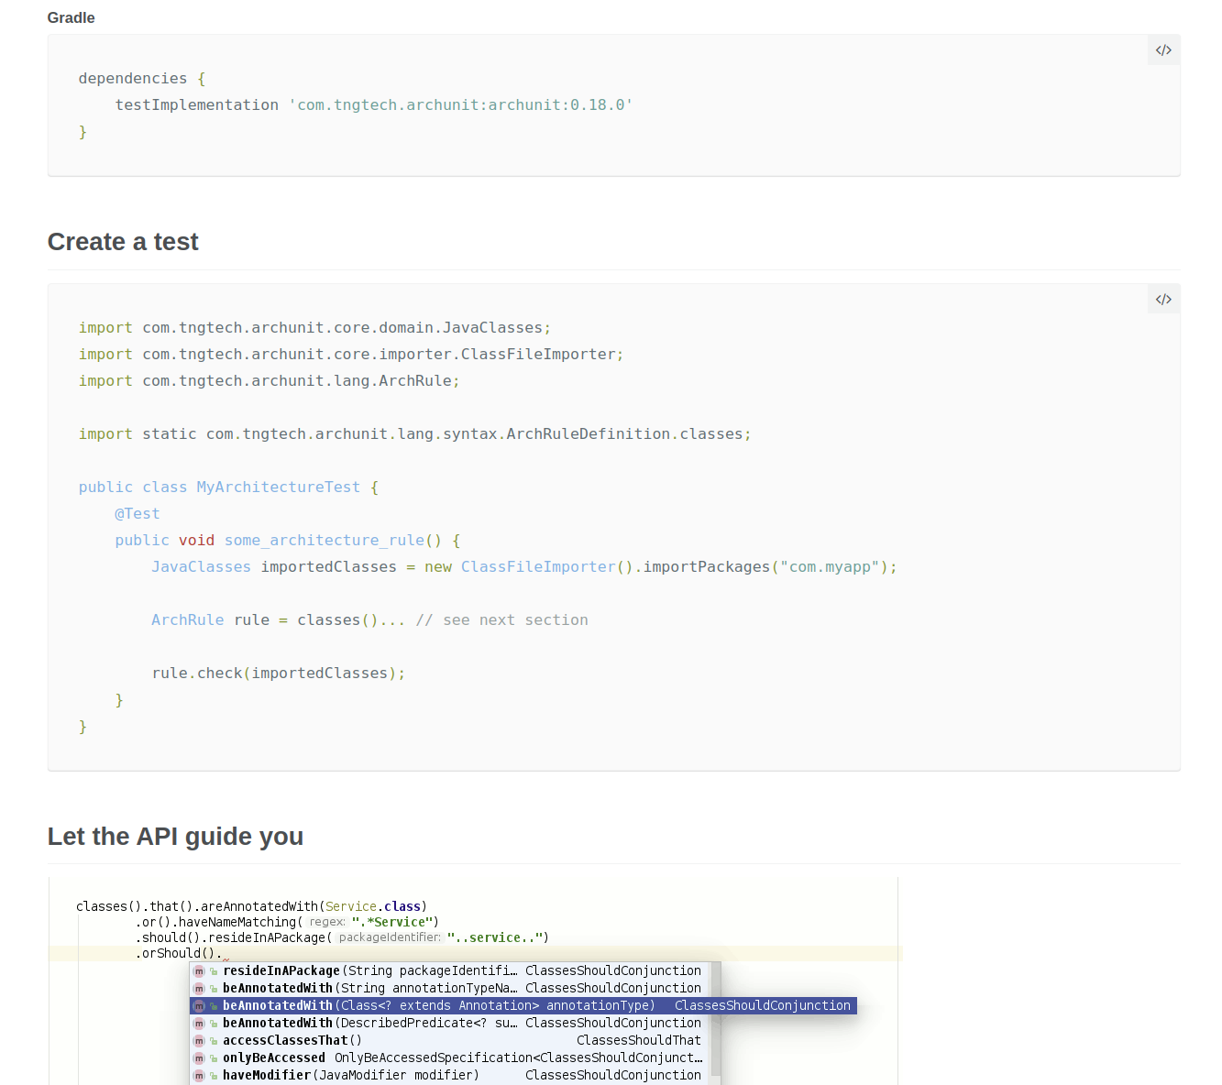
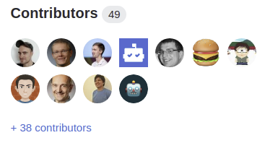
ArchUnit
https://www.archunit.org/getting-started

Slide 21

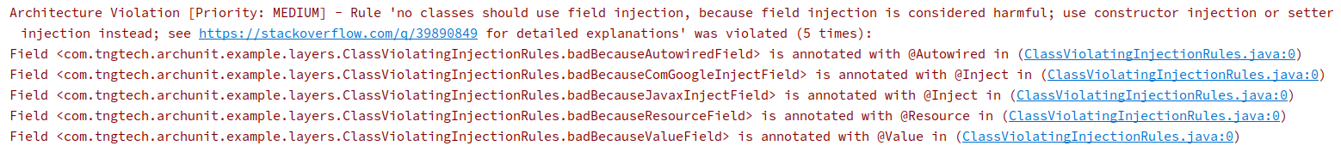
Example: Field injection

Slide 22
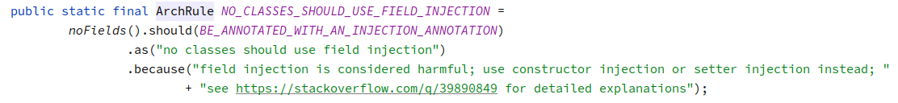
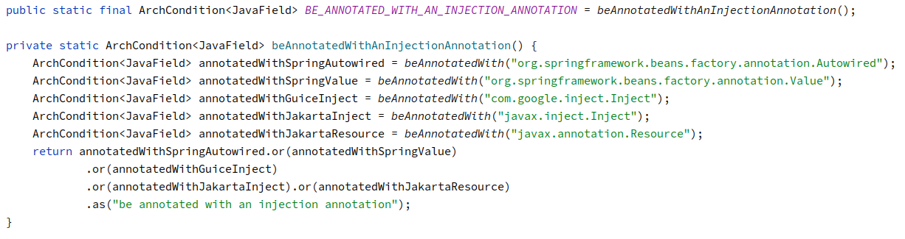
Example: Field injection

Slide 23
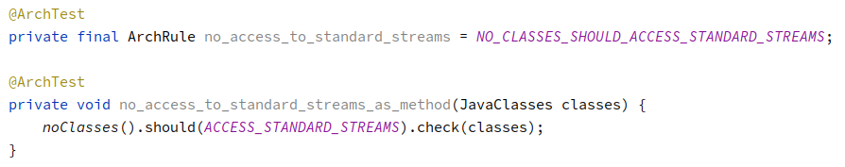
Example: Coding rules
System.out.println("Not allowed!");

Slide 24
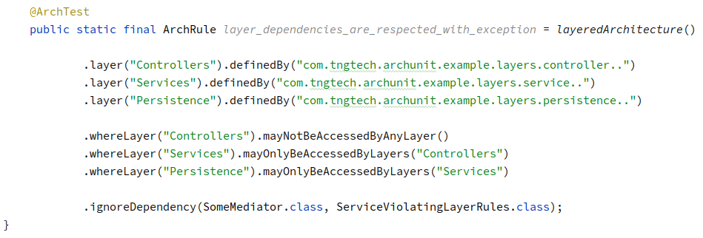
Example: layered architecture
Controller
Service
c
Persistence
ServiceViolatingLayerRules.class

Slide 25
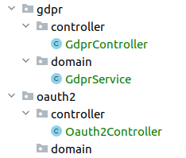
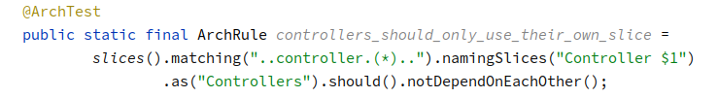
Example: Slices

Slide 26
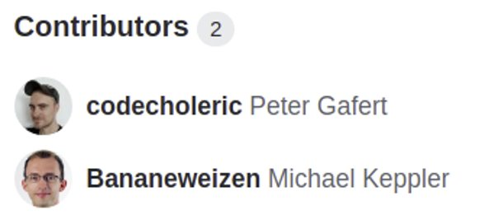
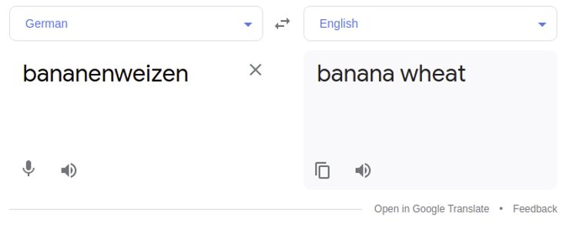
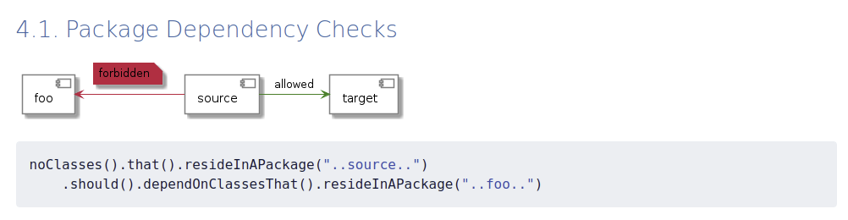
More examples
On GitHub: https://github.com/TNG/ArchUnit-Examples
In docs: https://www.archunit.org/userguide/html/000_Index.html#_what_to_check

Slide 27
The Rules

Slide 28
Rule #1: Access module using its API
Module can only be accessed via API
Notes:
Meant to be a simple rule to implement, though solving 80% of our concerns
We didn't see any more rules to add
maybe internal module onion architecture restrictions
However, it was fairly complex to achieve
Implementation: https://circlek.atlassian.net/browse/CDI-1192
Important: possibility to enable rules per each module separately
As full scan reported nearly 3k violations of that single rule

Slide 29
Rule #1: Access Module via API
OAuth & User
GDPR
T&C
BE: Module API
BE: Controller
BE: Services
BE: DAOs

Slide 30
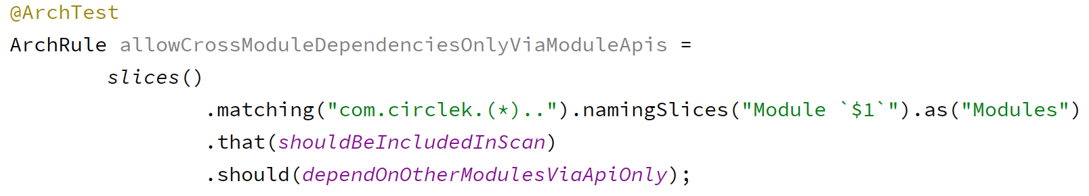
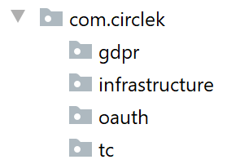
Rule #1: Implementation
Module `gdpr`
Module `infrastructure`
Module `oauth`
Module `tc`

Slide 31
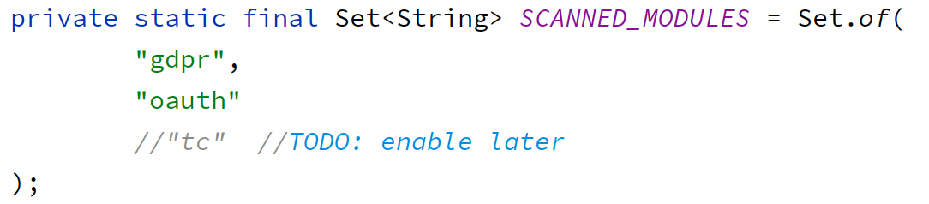
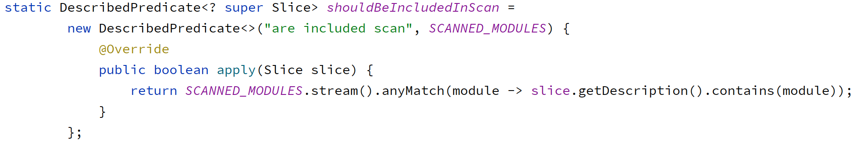
Rule #1: Should be included in scan

Slide 32
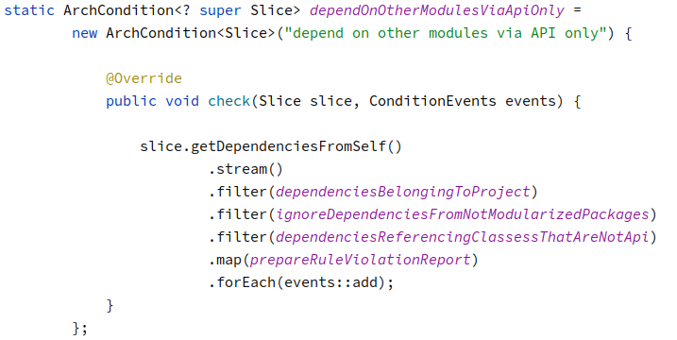
Rule #1: Rule check
Check who the class is calling
Exclude `java.util.List`, etc.
Exclude infrastructure, utils, etc.
Check the rule
Prepare rule violation message

Slide 33
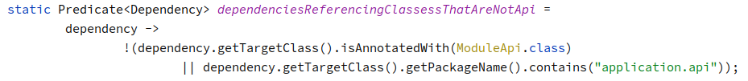
Rule #1: Actual dependency check

Slide 34
Rule #2: Module has API
Each business module must have an API
Notes:
Implemented as a secondary rule, because we already had it
All started with @ModuleApi class as a module API / facade
However also commands, events, result classes are the API
so we ended up with an `application.api` packages

Slide 35
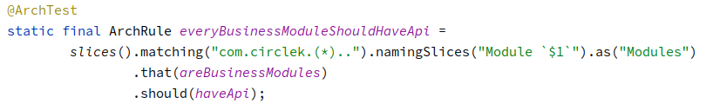
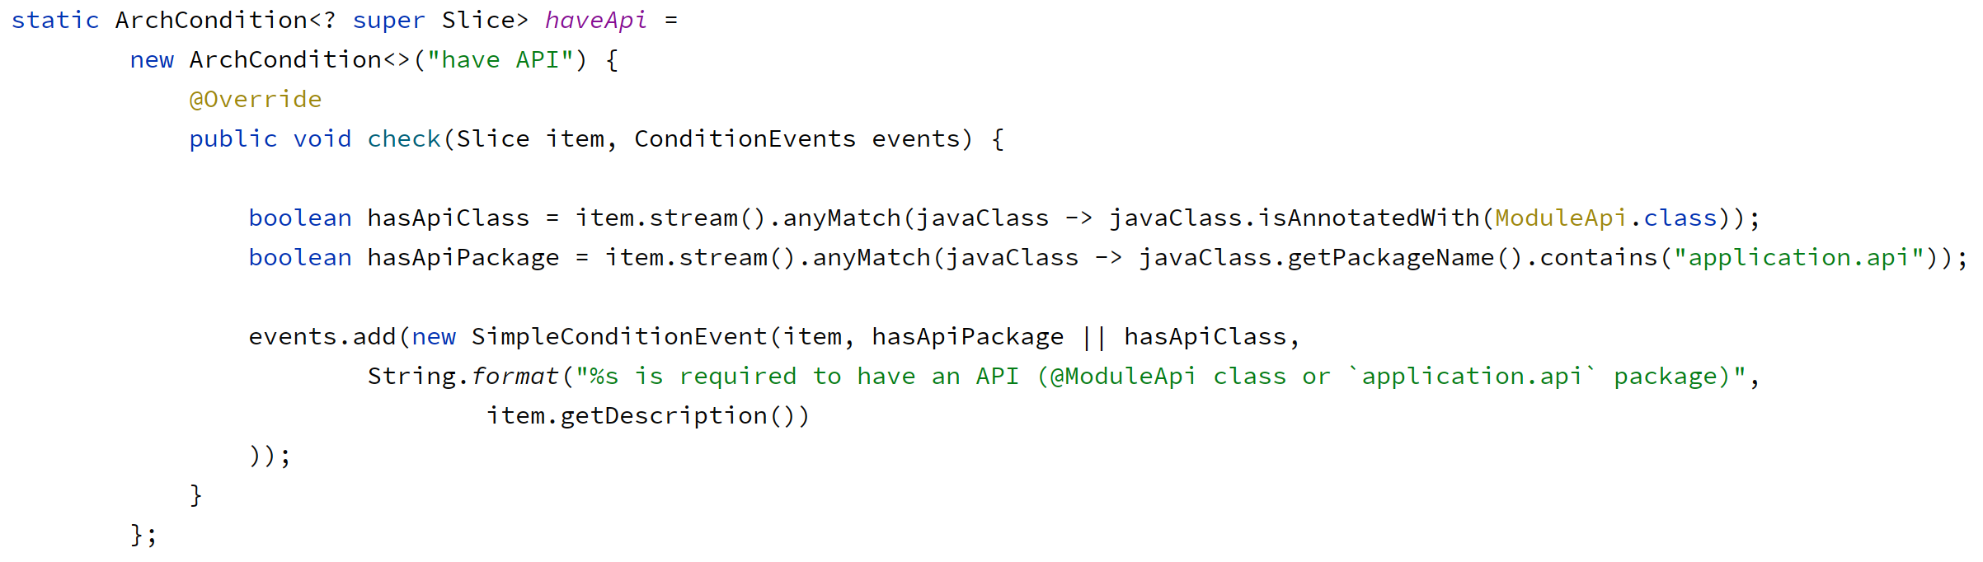
Rule #2: Implementation

Slide 36
Rule #3: Module API is unit tested
Every Module API method must have tests
Notes:
failed to implement it as Spock tests are not seen as accessors of the methods in @ModuleApi
Not a strong requirement, though
Does all Query methods need unit tests?

Slide 37
Rule #4: Module internal architecture
Layered?
Onion?
CRUD?

Slide 38
Implementig it

Slide 39
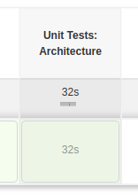
New build step
CI Build got a new step to verify Architecture rules

Slide 40

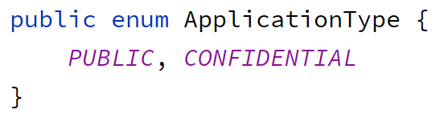
Start with a simple one
Identified utility classes
Elevated DTO to Module API
Notes:
Full scan reported 5k violations of that single rule
Will implement Module by module
started with a small, fresh module: requestsignatures
we knew it was written in line with manually enforced rules / practices
Reported 56 violations
Identified utility classes defined inside of a business module
UuidParser was moved to `tools` / Aka utils / commons / shared / …
Identified a class that was a part of the module contract (DTO)
ApplicationType enum was moved as Module API

Slide 41
Approach
Enable the rule to see tests fail
Make tests pass with a minimal effort
Fix the design in separate PRs

Slide 42
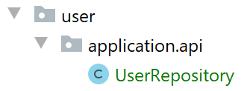

The next one
UserRepository in module API
ClientIdParser as a code smell
Notes:
Then we went to T&C https://github.com/circlekeurope/circlekid/pull/2346
Big repackaging, moving stuff that was obvious, did not require implementation
To avoid conflicts, complex PR
PR was on 374 files
ClientIdParser was identified as a code smell
was to be moved to `tools` temporarily, removed in a separate task
It parsed String to UUID and threw a business exception
Exception was related to oauth2 business rules, however not fitting to others
But the Parser was also used in other modules
We separated parsing, from business logic and exceptions
UserRepository was put in module API
because it was used by other modules so to make rules pass, we put it temporarily in API
also we untangled the dependency straight away in a same sprint
TBR: UserSession Http related knowledge was used in the domain
Moved the dependency to the Http Controller, outside of the domain
TBR: Region class was identified as a Value Object shared kernel
it was in `commons` module which consisted of more classes than only shared model
new package `shared` was created to group shared model
Also we had a discussion whether it is needed, is it actually shared
Was used in oauth and user module, but out of two, in oauth it is not really needed. We planned to remove it from there
Good to have such discussion on Mob sessions, only case for mob that is compelling to me

Slide 43
Mob programming
When you more need to discuss than to code

Slide 44
Other simple modules
LoggingContext moved to cross-cutting logging package
DeviceName moved to shared models
Notes:
Dashboard and OT modules
Simple case
only one Logging Context Class moved to cross-cutting logging package
https://github.com/circlekeurope/circlekid/pull/2354
UserDevice module
Small module, simple one
Only Device name Value Object was moved from legacy `commons` to new `shared` module that groups shared models

Slide 45
Then it started to get boring
Following refactorings were similar
Notes:
when 50% of the modules were done
First, I thought that presentation will be boring
but actually it's a message to you that once you start, then it will be easier
But on the flip side... I was hoping (my Scrum Master too) that following modules will be smaller tasks
Because partially code was already organized
But they weren't
Each module scan produced ~4 follow up tasks on refactoring the findings

Slide 46
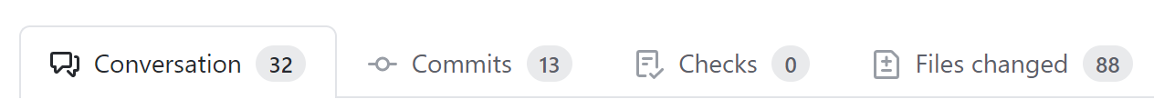
Create a new module
From classes scattered across whole code base
…and used from anywhere
Notes:
Remember me - its classes were scattered across whole code base and repository class was used everywhere
https://github.com/circlekeurope/circlekid/pull/2397
Pretty mechanical job, not complex, but time consuming
Creating a module is a pretty click-consuming job

Slide 47
Largest modules comes last
Starting with small was good
A trap: Cohesion
Notes:
Biggest modules comes last: user and oauth
Shared model on `registration` and `user` module: https://circlek.slack.com/archives/GRX2N2UEM/p1617026778191800
Starting with small was good
problems that were big at the beginning were not that big when tackling most important modules in the end
There was one trap, though: Cohesion
`user` and `user registration` were separate modules, however user property `Address` is used in both
Therefore `Address` had to be migrated to `shared` classes, even though it's not that much shared other than between just two modules.
So cohesion is pretty small in this case
Submodules would fit here

Slide 48

Cohesion
user
signup
tc
shared
gdpr
oauth

Slide 49
Are we done?

Slide 50
Next steps
Submodules?
Rules on module internals?
Notes:
Submodules?
Rules on module internals
But we'll start with refining the rules, observing first
Rules' implementation will come next once we're sure what we need

Slide 51
Thank you
Jacek Milewski
jacek.milewski.k@gmail.com
@jacek_mil

